Slide 1


Web Based
Impervious Cover
Decision Making Tool
Sheneeka Ward
James Yang
National Aeronautics and
Space Administration
Stennis Space Center
December 12, 2013

Slide 2
Overview
Impervious Surfaces
Methods of Impervious Cover Analysis
Our Goals
Automation of Impervious Cover Map Production
Web Application Infrastructure
Demonstration

Slide 3
Overview
Impervious Surfaces
Methods of Impervious Cover Analysis
Our Goals
Automation of Impervious Cover Map Production
Web Application Infrastructure
Demonstration

Slide 4
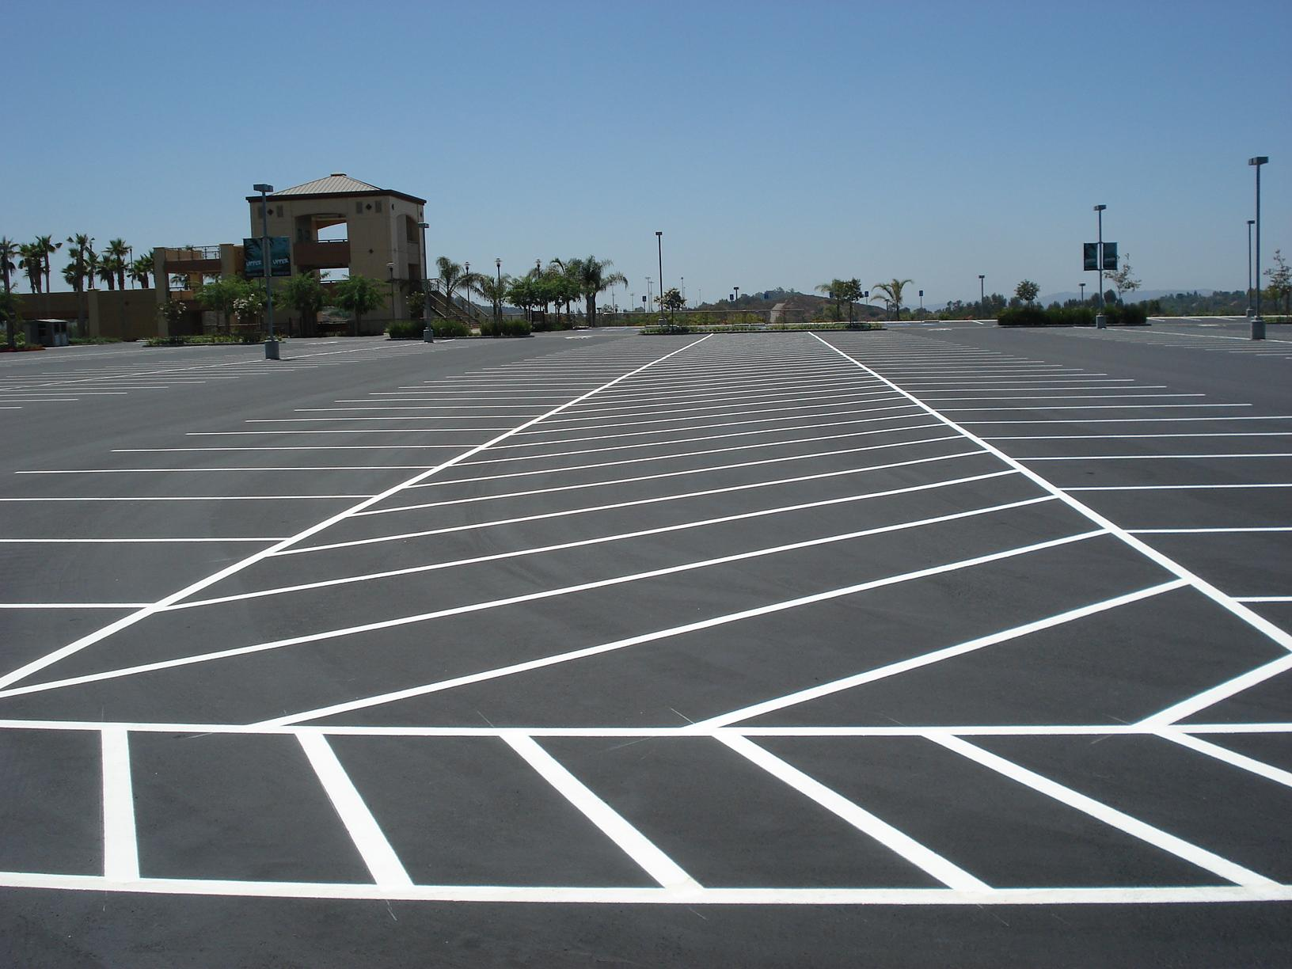

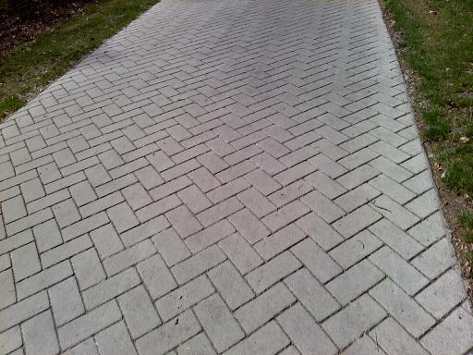
Impervious Surfaces
Artificial structures covered by impervious materials
Asphalt
Concrete
Brick
Stone

Slide 5
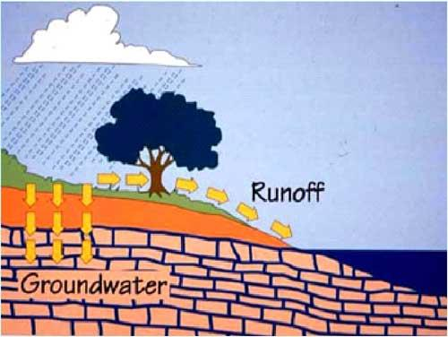
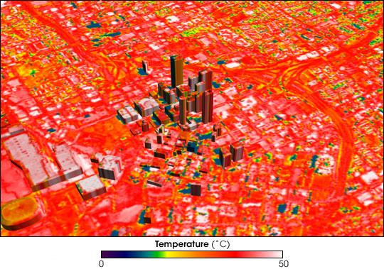
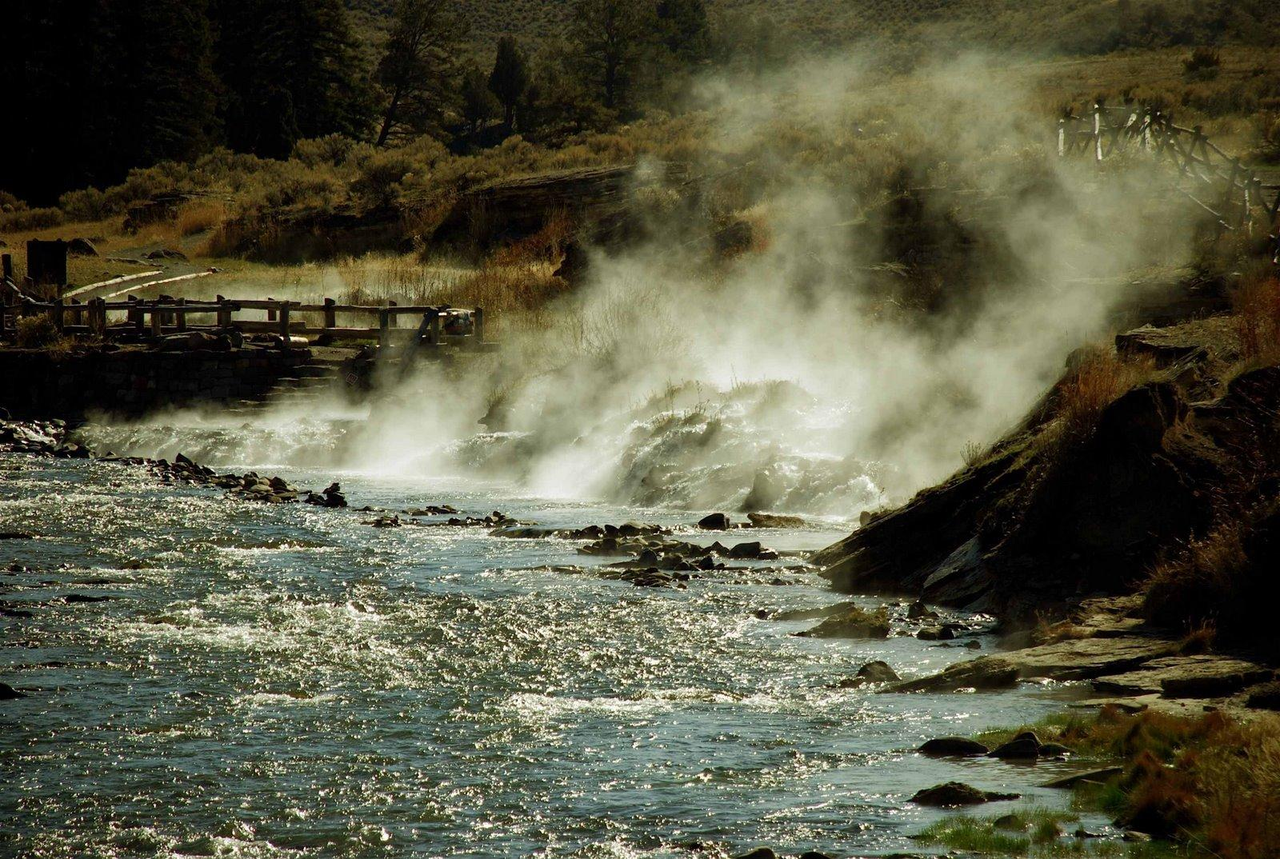
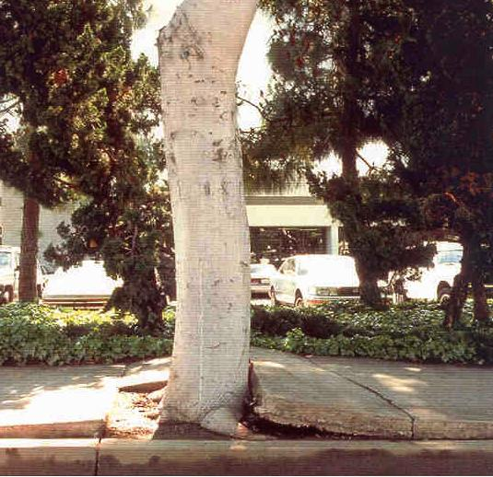
Impervious Surfaces
Environmental Issues
Dirty runoff → water contamination
Heat islands → excess energy consumption
Excess heat transport during rainfall → O₂ purge in water
Deprive tree root aeration → impacted carbon cycling

Slide 6
Overview
Impervious Surfaces
Methods of Impervious Cover Analysis
Our Goals
Automation of Impervious Cover Map Production
Web Application Infrastructure
Demonstration

Slide 7
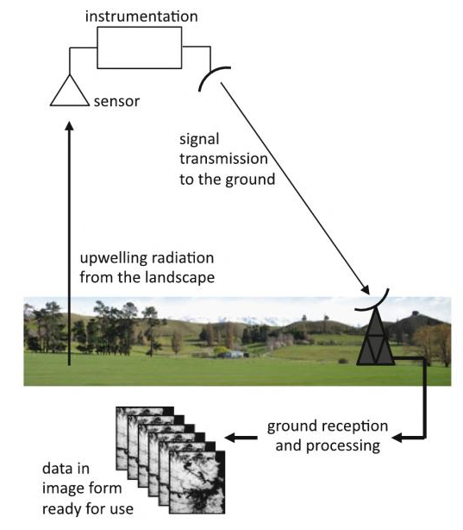
Methods of Impervious Cover Analysis
Field work
Taking samples and directly experimenting with absorption rates
Remote Sensing
Backscatter radiation capture for spectral analysis

Slide 8
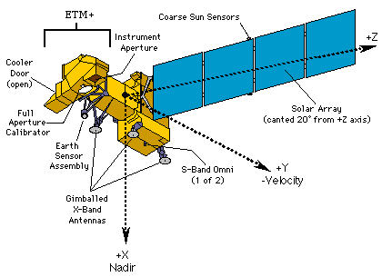
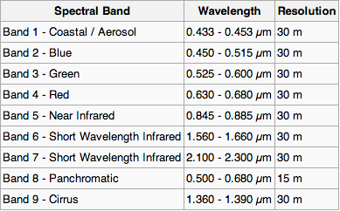
Methods of Impervious Cover Analysis
Satellite Imagery
Landsat 8 Spectral Bands

Slide 9
Overview
Impervious Surfaces
Methods of Impervious Cover Analysis
Our Goals
Automation of Impervious Cover Map Production
Web Application Infrastructure
Demonstration

Slide 10
Our Goals
Automate the impervious cover product generation process
Create a web application to visualize impervious cover data

Slide 11
Overview
Impervious Surfaces
Methods of Impervious Cover Analysis
Our Goals
Automation of Impervious Cover Map Production
Web Application Infrastructure
Demonstration

Slide 12
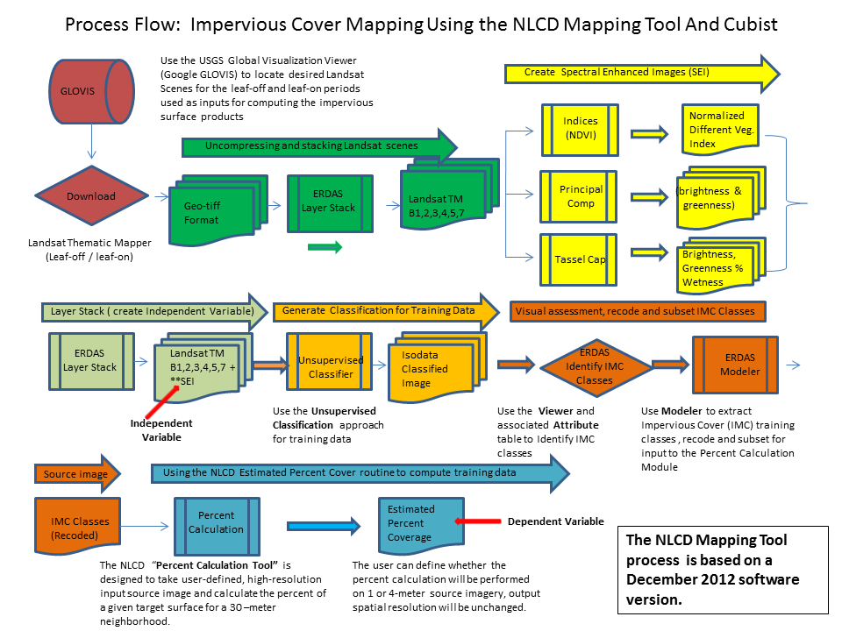
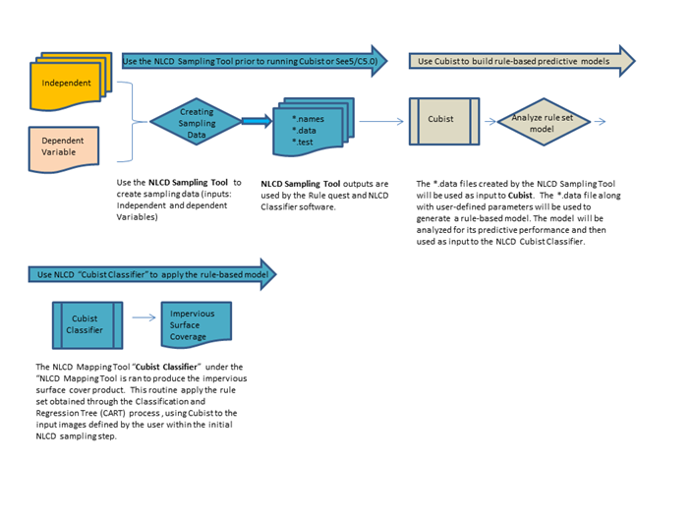
Automation

Slide 13
Automation
Data Preparation
Pixel Classification
Percent Imperviousness Value Assignment

Slide 14
Automation
Percent Imperviousness Value Refinement

Slide 15
Automation
Data Preparation

Slide 16
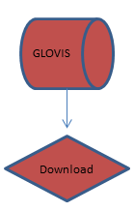
Automation: Data Preparation
Downloading Satellite Imagery

Slide 17
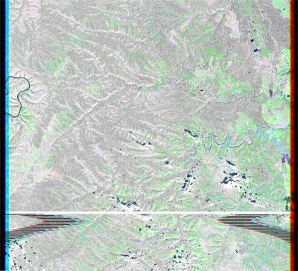
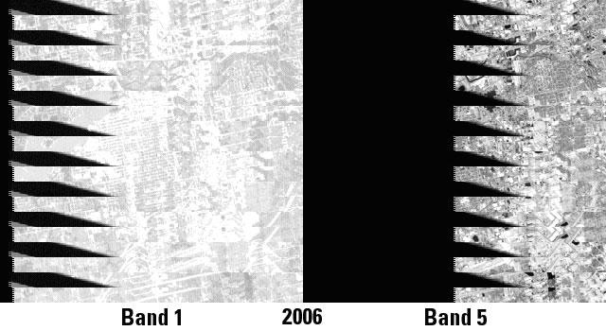
Automation: Data Preparation
Download satellite images
USGS Global Visualization Viewer (GloVis)
Reject unusable data
Anomalies with imagery from Landsat 7*
*http://landsat.usgs.gov/science_an_anomalies.php
Alternative sources of satellite imagery
Google Earth Engine

Slide 18
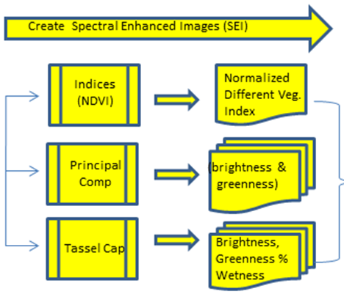
Automation: Data Preparation
Spectral Enhancement

Slide 19
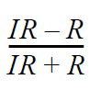
Automation: Data Preparation
Normalized Difference Vegetation Index (NDVI)
IR is the near-infrared band
R is the visible red band

Slide 20
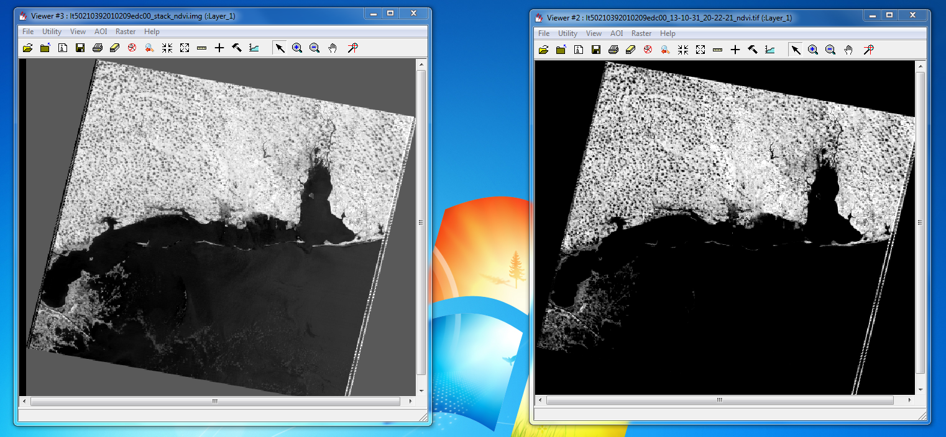
Automation: Data Preparation
ERDAS
MATLAB
NDVI Comparison: ERDAS vs. MATLAB

Slide 21
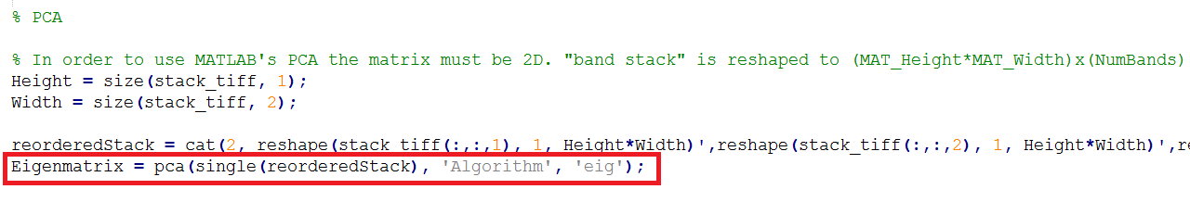
Automation: Data Preparation
Principal Component Analysis
Compresses common patterns into fewer bands.
For this process we used the 1st and 2nd principal components (brightness and greenness).

Slide 22
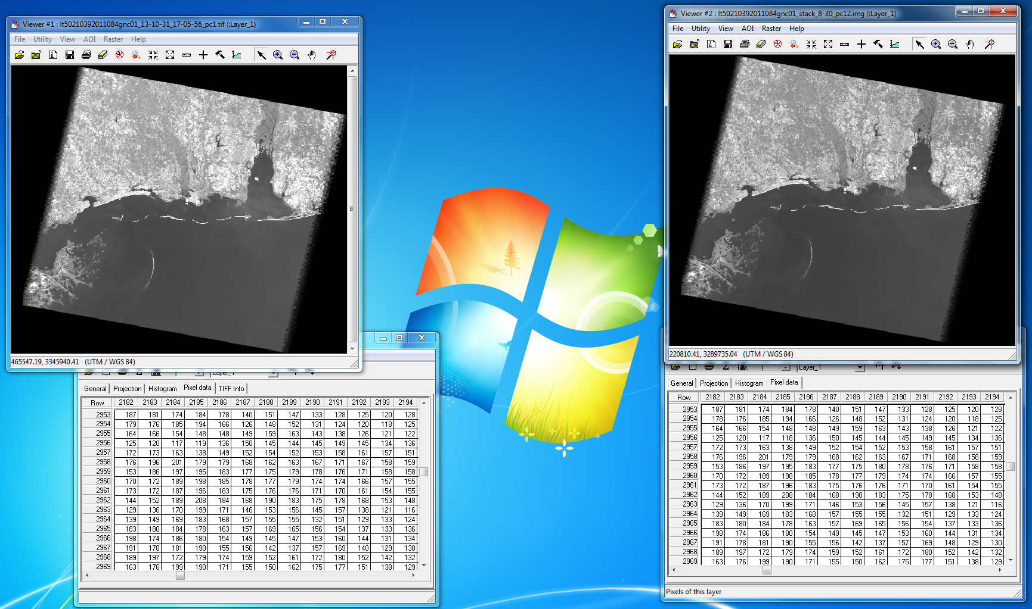
Automation: Data Preparation
MATLAB
ERDAS
PCA Comparison: ERDAS vs. MATLAB

Slide 23
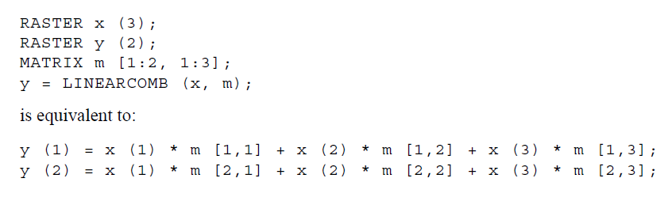
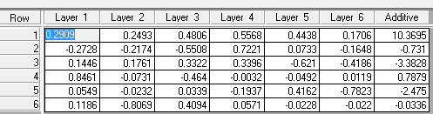
Automation: Data Preparation
Tasseled Cap Transformation (TC)
Transformation that enhances vegetation features
Brightness, greenness, and wetness

Slide 24
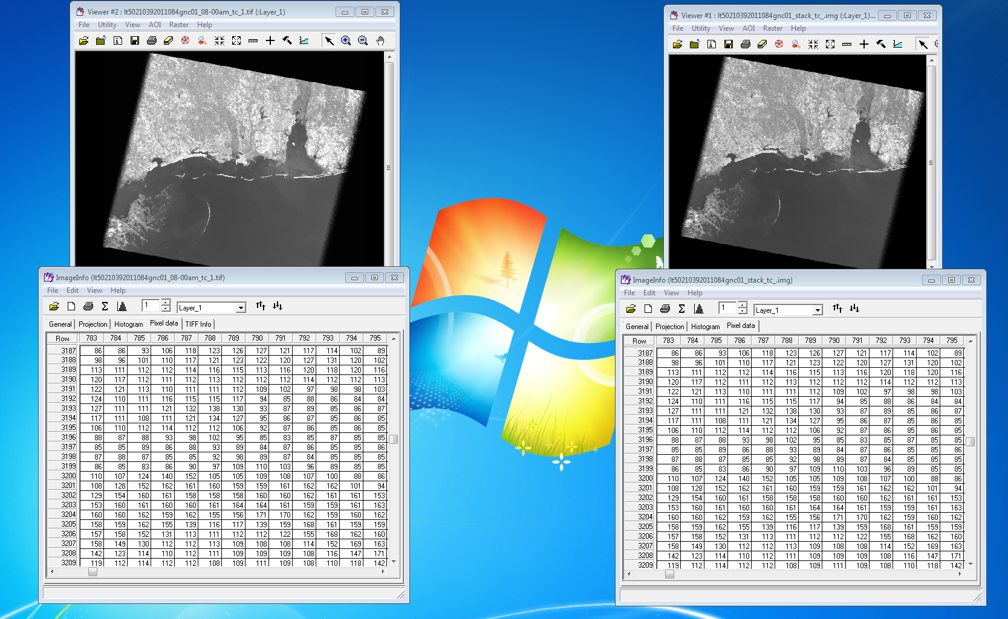
Automation: Data Preparation
MATLAB
ERDAS
TC Comparison: ERDAS vs. MATLAB

Slide 25
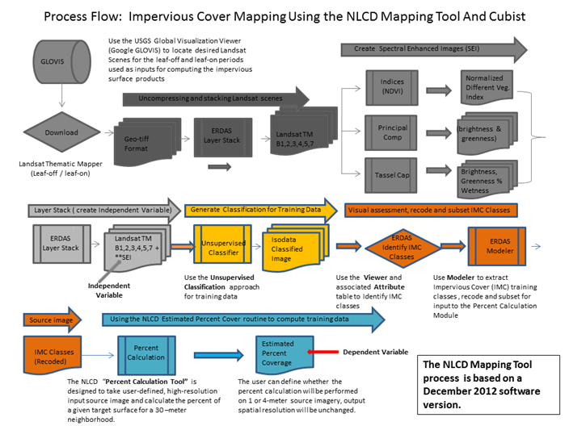
Automation
Pixel Classification

Slide 26
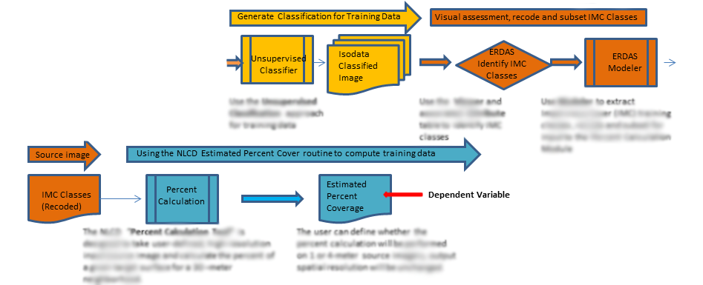
Automation: Pixel Classification

Slide 27
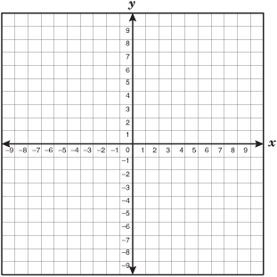
Automation: Pixel Classification
ISODATA Algorithm
Each pixel is a 24 dimensional vector
Pick 40 random pixels and call them “cluster centers”
All other pixels are grouped with their closest “cluster center”
Remove clusters that don’t have the minimum number of pixels, move each cluster center to the centroid of each cluster, and reassign pixels as needed
Calculate the standard deviation of each cluster distribution
If standard deviation minimum is not met for a cluster, split the cluster in half and recluster the pixels
If clusters are too close to each other, merge those clusters and recluster the pixels
Reiterate until minimum standard deviation, minimum cluster distance, or convergence; or until number of maximum iterations is reached

Slide 28
Automation: Pixel Classification
Assigning Percent Imperviousness Values
Assign each cluster an estimated percent imperviousness value from a lookup table
Category 1: 100%
Category 2: 25%
Category 3: 80%
Category 4: 62%
Category 5: 65%
Category 6: 47%
Category 7: 31%
Category 8: 98%
Category 9: 10%
…

Slide 29
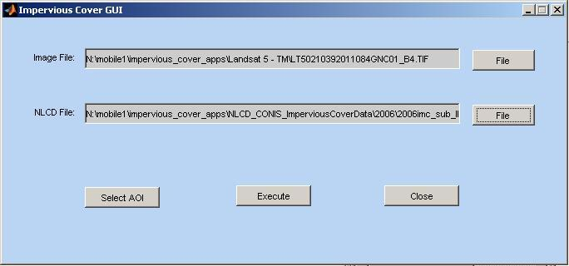
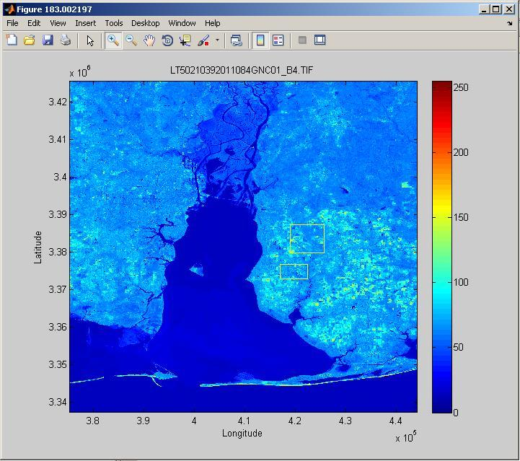
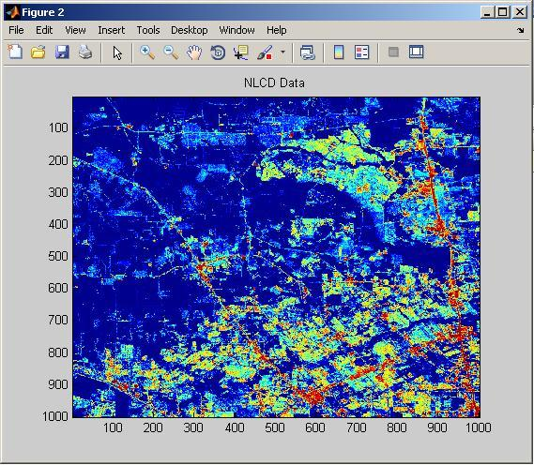
Automation: Pixel Classification
Impervious Cover Selection GUI:
National Land Cover Database (NLCD)

Slide 30
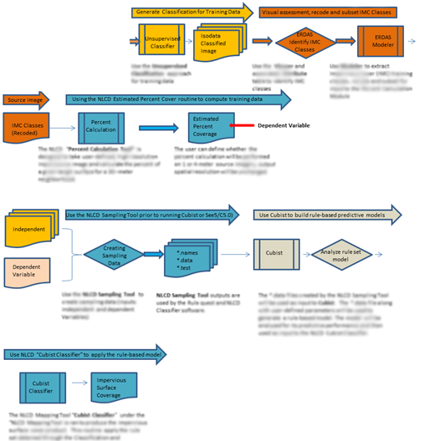
Automation: Work in Progress

Slide 31
Overview
Impervious Surfaces
Methods of Impervious Cover Analysis
Our Goals
Impervious Cover Data Production
Web Application Infrastructure
Demonstration

Slide 32
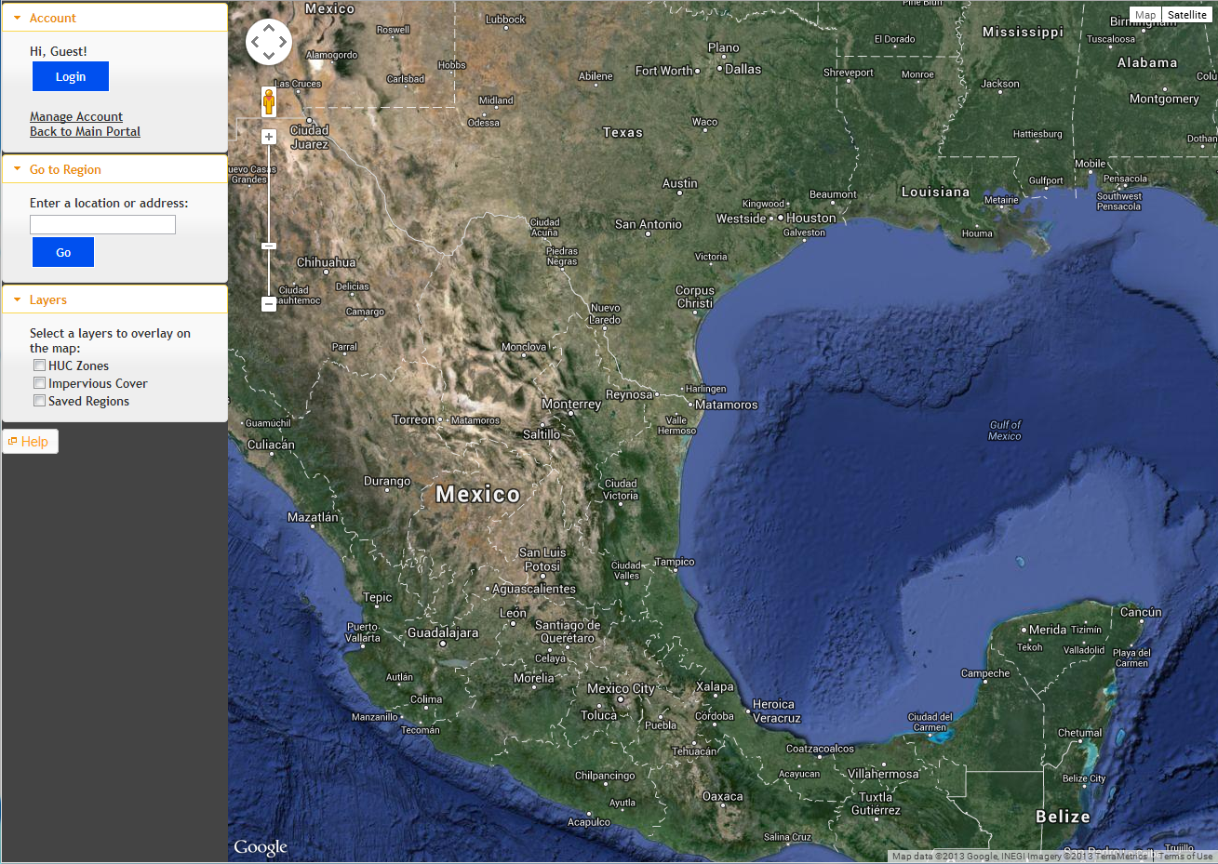
Web Application Infrastructure
Cloud Server
Google Servers
Automated IC Process
MySQL
PHP
Fusion Tables
Maps
Apache
Python
Login Data
IC Calculations
Image Overlay
Client
HUC Zone Overlay
Google Maps Engine

Slide 33
Overview
Impervious Surfaces
Methods of Impervious Cover Analysis
Our Goals
Impervious Cover Data Production
Web Application Infrastructure
Demonstration

Slide 34
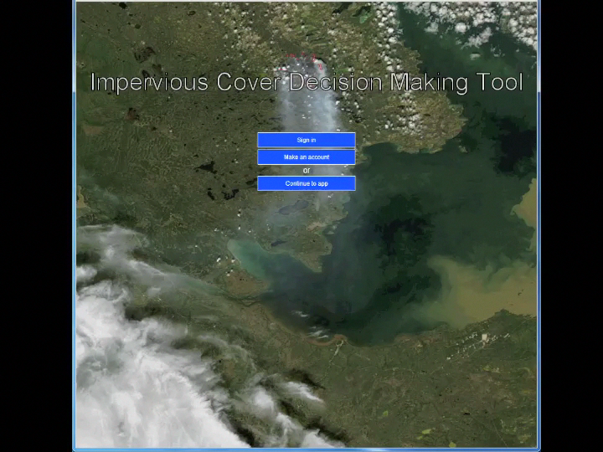
Demonstration

Slide 35
Acknowledgements
We would like to thank...
Mentors:
Duane Armstrong, Ted Mason
SSC Education Program Coordinator:
Nancy Bordelon
ARTS:
Shannon Ellis, Gerry Gasser,
Carolyn Owen, Laura Pair,
James “Doc Smoot, Joe Spruce

Slide 36
Thank you!

